Slide 1
Introduction to RStudio
Elmer Poliquit

Slide 2
Introduction to RStudio
Section Outline
The RStudio Interface
Basic Data Management and Functions in Rstudio
Vectors and Matrices
Plots
Reading External Data

Slide 3
The RStudio Interface
What is ?
R is an open-source software environment for statistical computing and graphics.
It has a worldwide repository system called the Comprehensive R Archive Network (CRAN) http://cran.r-project.org to download the software and user-contributed add-on packages.
The R language is case sensitive.

Slide 4

The RStudio Interface
What is Studio?
RStudio is an Integrated Development Environment (IDE) that facilitates issuing of commands in R interactively.
It has many convenient and easy-to-use tools for coding, plot management, object browsing, package management, among other things.
To download RStudio: https://www.rstudio.com/

Slide 5
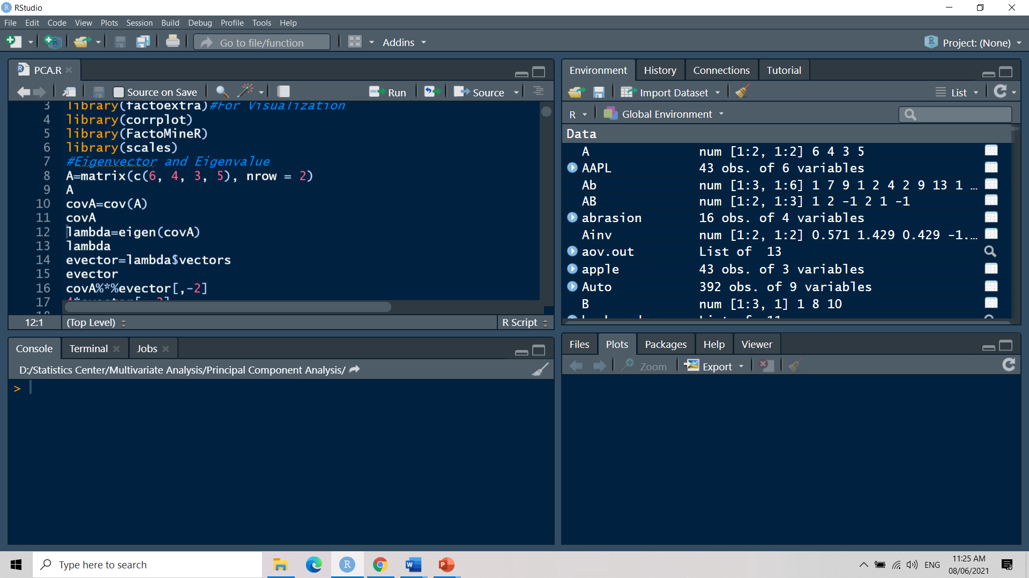
The RStudio Interface
1
3
2
4

Slide 6
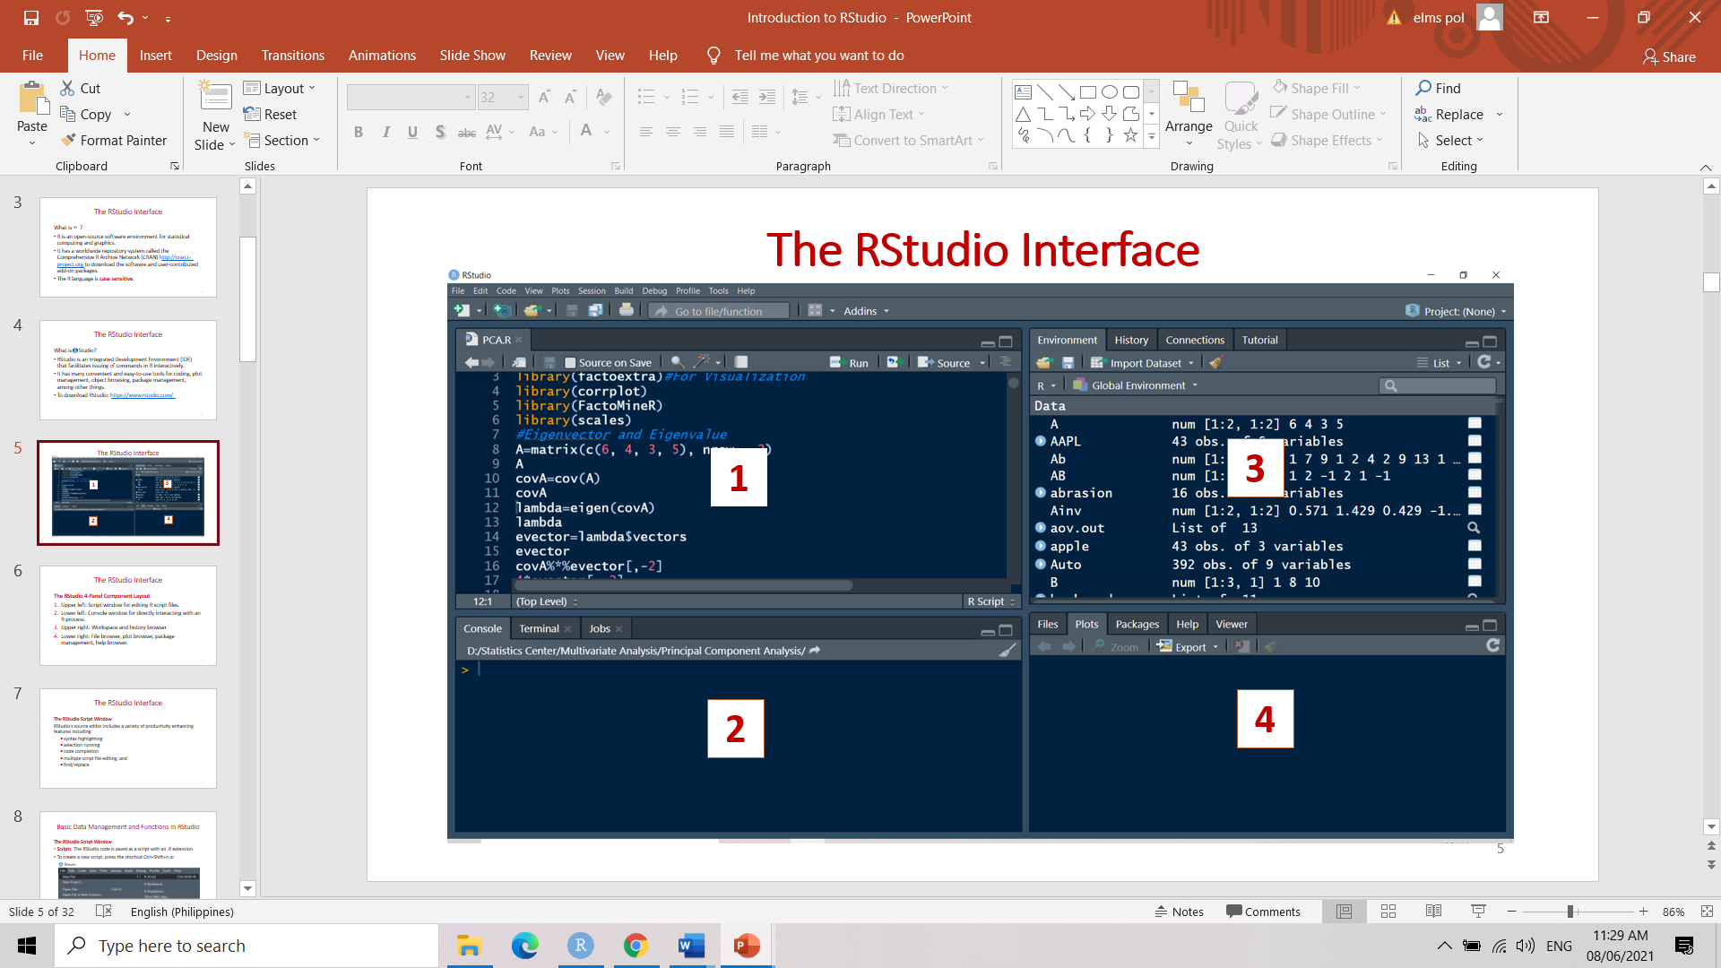
The RStudio Interface
The RStudio 4-Panel Component Layout
Upper left: Script window for editing R script files.

Slide 7
The RStudio Interface
The RStudio 4-Panel Component Layout
Lower left: Console window for directly interacting with an R process.

Slide 8
The RStudio Interface
The RStudio 4-Panel Component Layout
Upper right: Workspace and history browser

Slide 9
The RStudio Interface
The RStudio 4-Panel Component Layout
Lower right: File browser, plot browser, package management, help browser.

Slide 10
The RStudio Interface
The RStudio Script Window
RStudio's source editor includes a variety of productivity enhancing features including
syntax highlighting
selection running
code completion
multiple script file editing, and
find/replace.

Slide 11
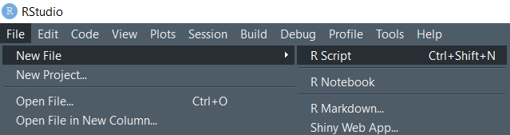
Basic Data Management and Functions in RStudio
The RStudio Script Window
Scripts. The RStudio code is saved as a script with an .R extension.
To create a new script, press the shortcut Ctrl+Shift+n or

Slide 12
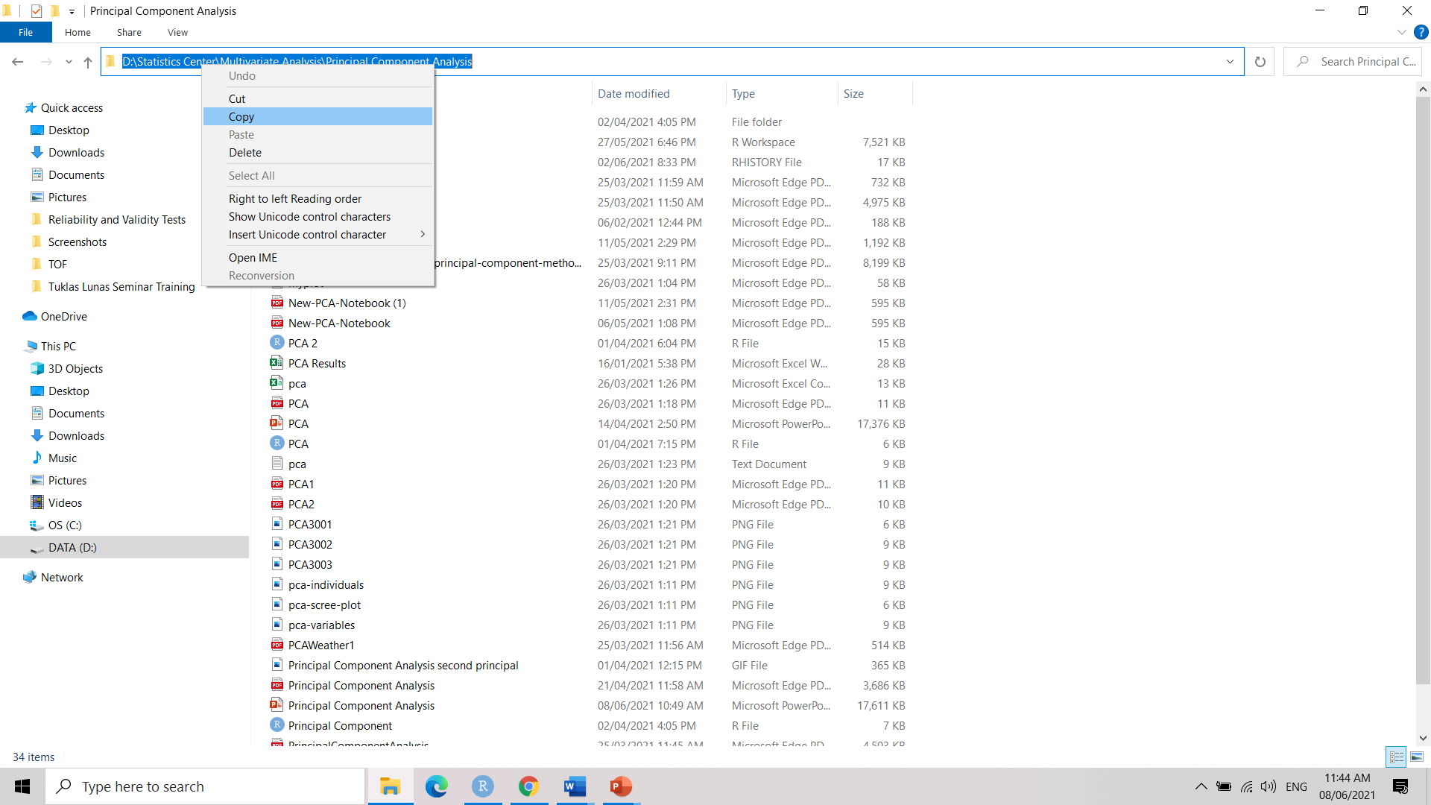
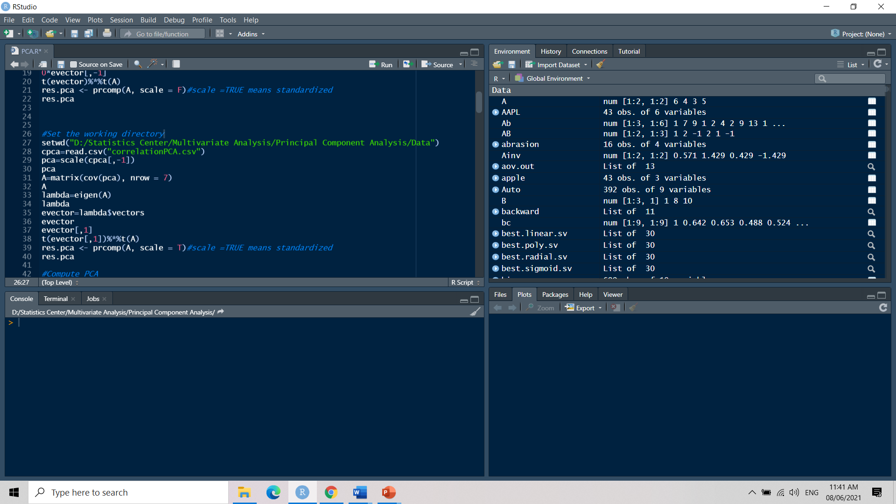
Basic Data Management and Functions in RStudio
The RStudio Script Window
Working directories. To set a working directory that contains the datasets to be used in the program, use the setwd() command. An example is:
When copy-pasting directories, make sure to change \ to /.
Comments. These make source code easier for us to understand, and are generally ignored by the computer.
Comments are preceded by the # symbol.

Slide 13
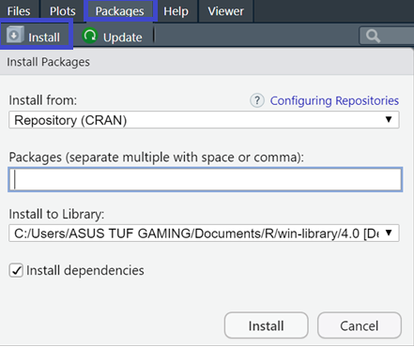
Basic Data Management and Functions in RStudio
Installing Packages
The packages tab in the lower right panel can be used to install and load different packages.

Slide 14
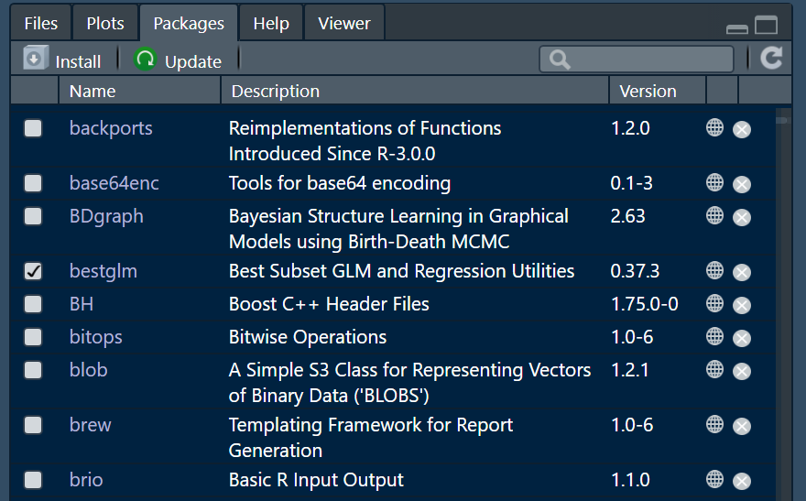
Basic Data Management and Functions in RStudio
Installing Packages
Loaded packages are marked with a check ✓symbol.

Slide 15
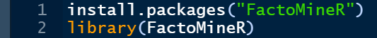
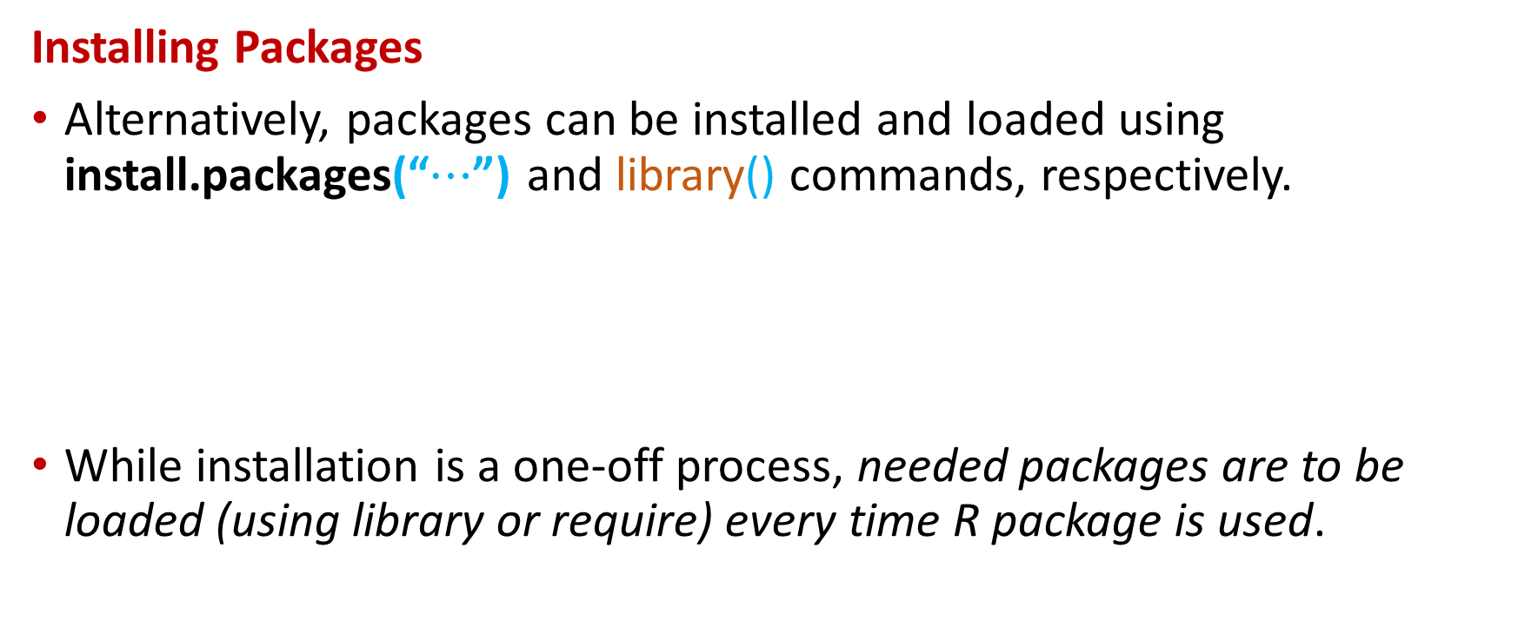
Basic Data Management and Functions in RStudio
Installing Packages
Alternatively, packages can be installed and loaded using install.packages(“$⋯$”) and library() commands, respectively.
While installation is a one-off process, needed packages are to be loaded (using library or require) every time R package is used.

Slide 16
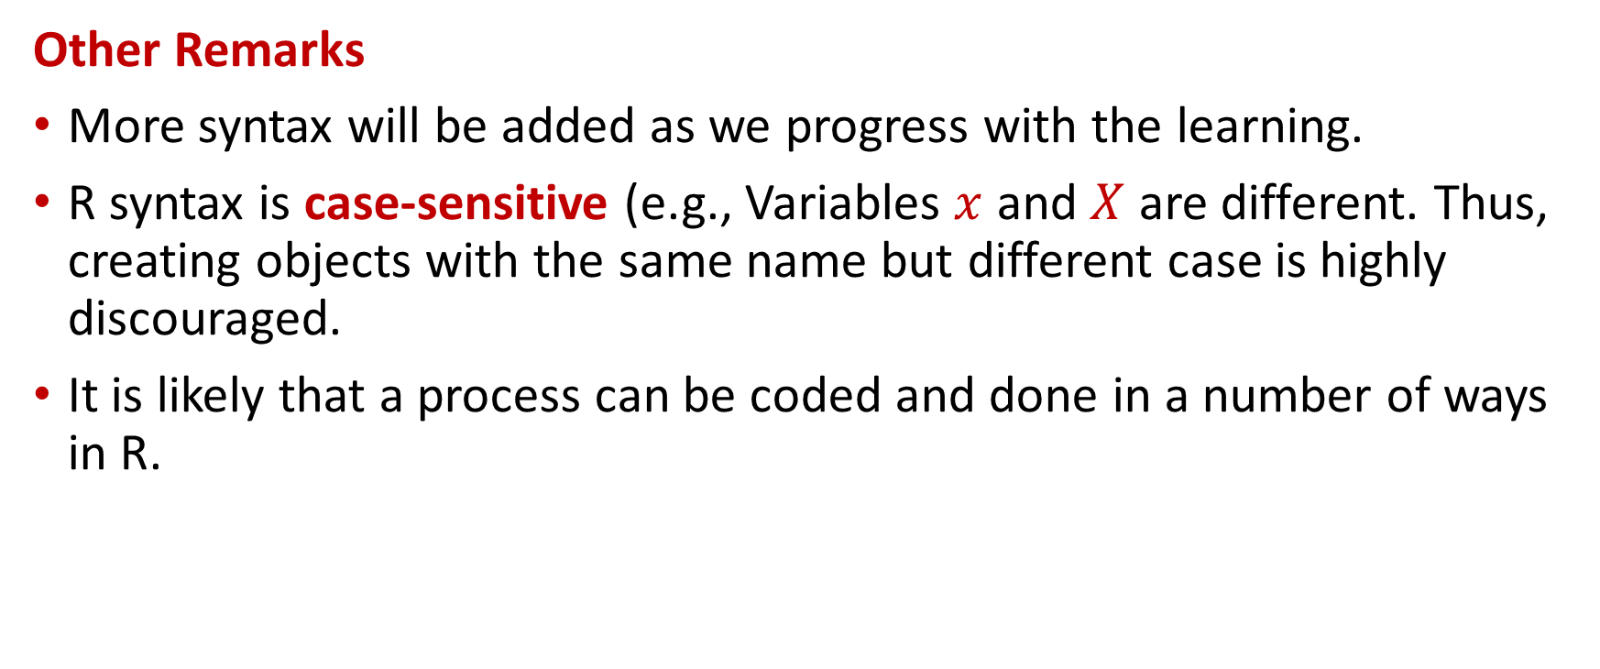
Basic Data Management and Functions in RStudio
Other Remarks
More syntax will be added as we progress with the learning.
R syntax is case-sensitive (e.g., Variables $x$ and $X$ are different. Thus, creating objects with the same name but different case is highly discouraged.
It is likely that a process can be coded and done in a number of ways in R.

Slide 17
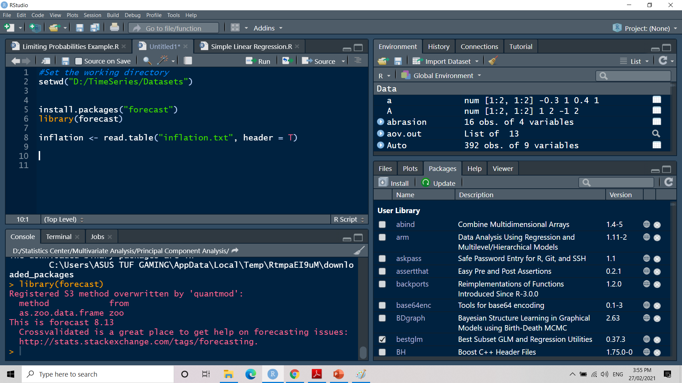
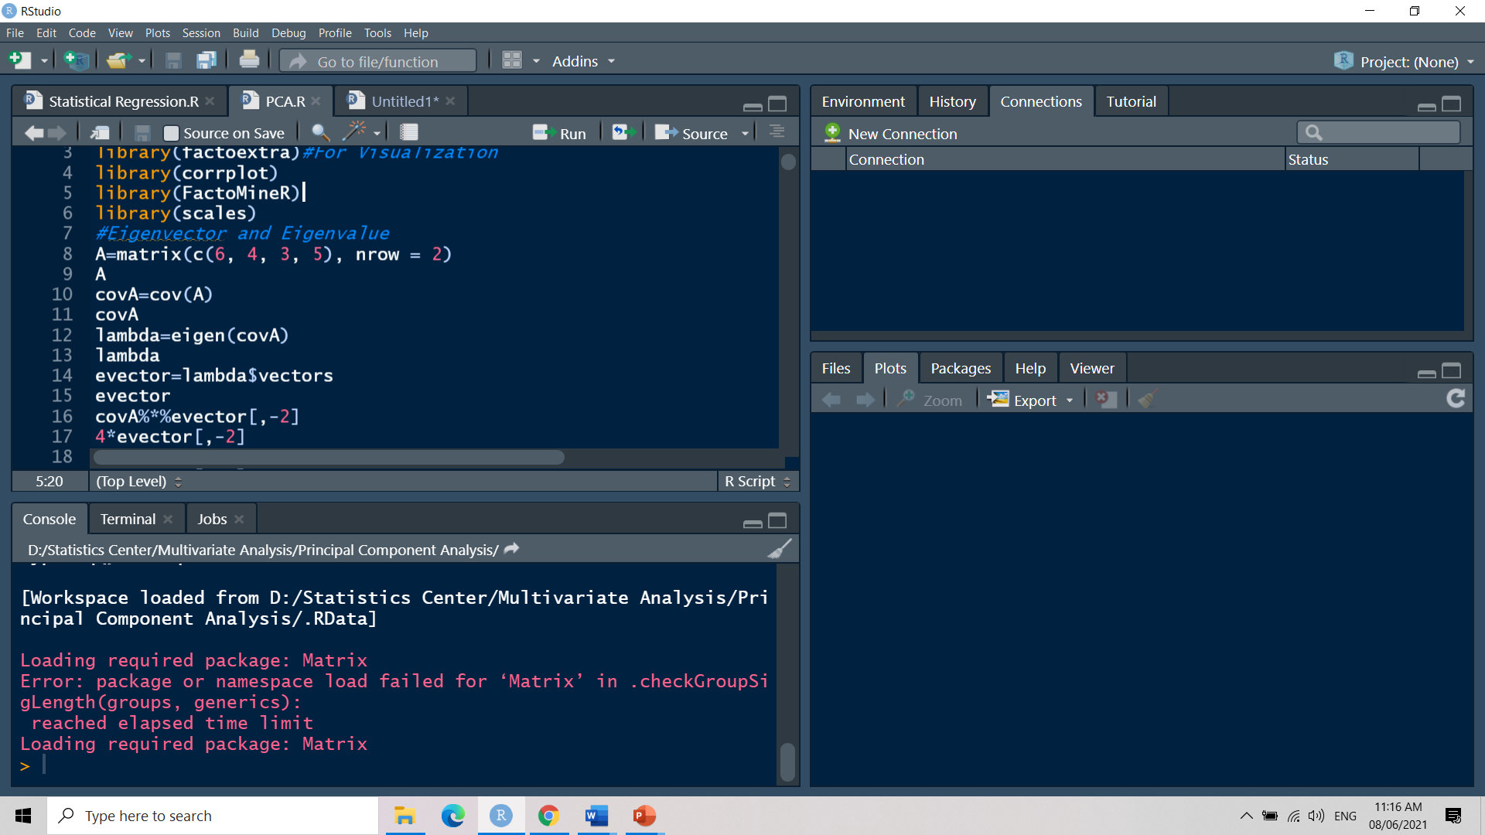
Basic Data Management and Functions in RStudio
Other Remarks
Assignment operator. R expressions at the right can be assigned to objects at its left using the assignment operator <- or =. Here, a dataset from the text file “inflation.txt” is assigned to an object at the left named “inflation” and a matrix named “A”.

Slide 18
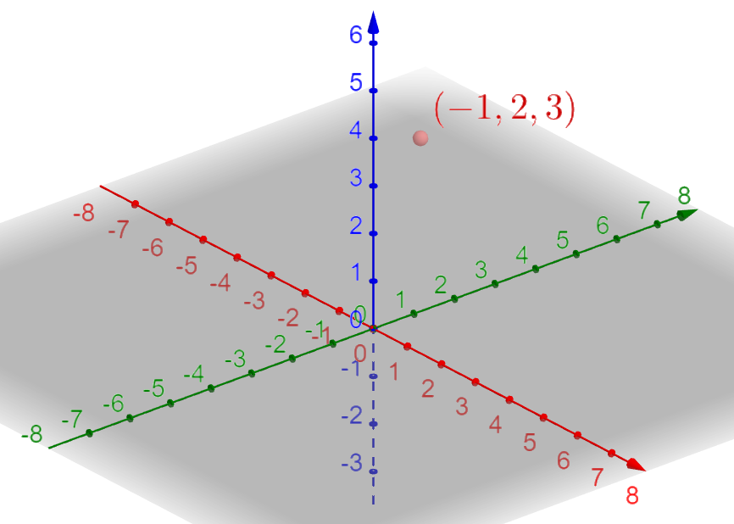
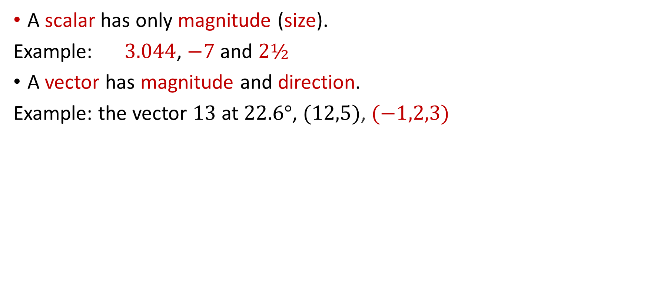
VECTOR
A scalar has only magnitude (size).
Example: $3.044$, $−7$ and $2½$
A vector has magnitude and direction.
Example: the vector $13$ at $22.6°$, $(12,5)$, $(−1,2,3)$

Slide 19
VECTOR
vector1 = 1:9 #The simplest way to create a vector
vector1
[1] 1 2 3 4 5 6 7 8 9 #Output of vector1
1.2:9 #The colon(:)operator creates a sequence of numbers from the left hand value to the right hand value, iterating in increments of 1.
[1] 1.2 2.2 3.2 4.2 5.2 6.2 7.2 8.2
vector2 = c(1, 3, 2, -8.1) #to make vectors is with numbers you specifically select
vector2
[1] 1.0 3.0 2.0 -8.1

Slide 20
VECTOR
vector3 = 9:1
vector3
[1] 9 8 7 6 5 4 3 2 1
vector1+vector3 #adding vectors
[1] 10 10 10 10 10 10 10 10 10
vector1+vector2 #R loops the smaller vector as many times as necessary to add something to each element of the larger vector
[1] 2.0 5.0 5.0 -4.1 6.0 9.0 9.0 -0.1 10.0
Note: Vector2 → [1] 1.0 3.0 2.0 -8.1

Slide 21
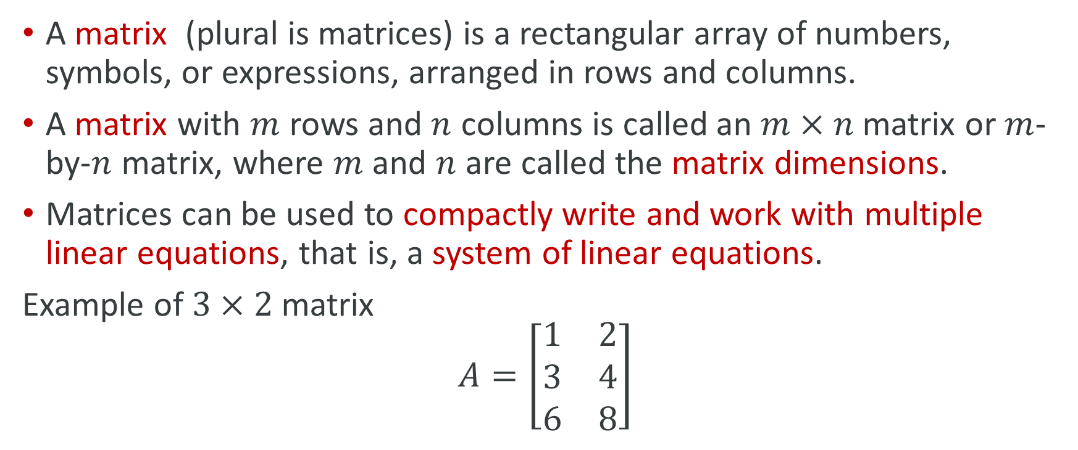
MATRIX
A matrix (plural is matrices) is a rectangular array of numbers, symbols, or expressions, arranged in rows and columns.
A matrix with $m$ rows and $n$ columns is called an $m×n$ matrix or $m$-by-$n$ matrix, where $m$ and $n$ are called the matrix dimensions.
Matrices can be used to compactly write and work with multiple linear equations, that is, a system of linear equations.
Example of $3×2$ matrix
$$A=\left[\begin{matrix}1 & 2 \\ 3 & 4 \\ 6 & 8\end{matrix}\right]$$

Slide 22
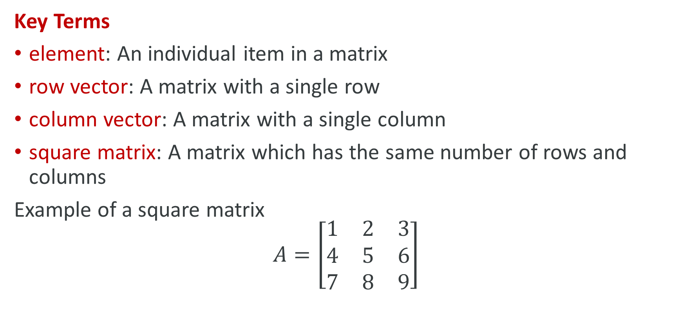
MATRIX
Key Terms
element: An individual item in a matrix
row vector: A matrix with a single row
column vector: A matrix with a single column
square matrix: A matrix which has the same number of rows and columns
Example of a square matrix
$$A=\left[\begin{matrix}1 & 2 & 3 \\ 4 & 5 & 6 \\ 7 & 8 & 9\end{matrix}\right]$$

Slide 23
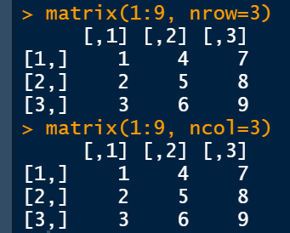
MATRIX
matrix(c(1, 2, 3, 4, 5, 6, 7, 8, 9), nrow = 3) #specified entries, nrow=number of rows
[,1] [,2] [,3]
[1,] 1 4 7
[2,] 2 5 8
[3,] 3 6 9
matrix(1:9, nrow=3) #using sequence (:)
matrix(1:9, ncol=3) #using ncol=number of columns

Slide 24
MATRIX
matrix1=matrix(1:9, nrow=3)
matrix1+3 #each entry in the matrix is added by 3
[,1] [,2] [,3]
[1,] 4 7 10
[2,] 5 8 11
[3,] 6 9 12

Slide 25
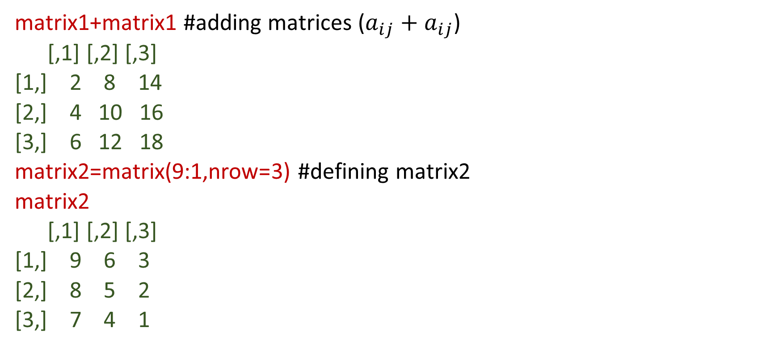
MATRIX
matrix1+matrix1 #adding matrices ($a_{ij}+$ $a_{ij}$)
[,1] [,2] [,3]
[1,] 2 8 14
[2,] 4 10 16
[3,] 6 12 18
matrix2=matrix(9:1,nrow=3) #defining matrix2
matrix2
[,1] [,2] [,3]
[1,] 9 6 3
[2,] 8 5 2
[3,] 7 4 1

Slide 26
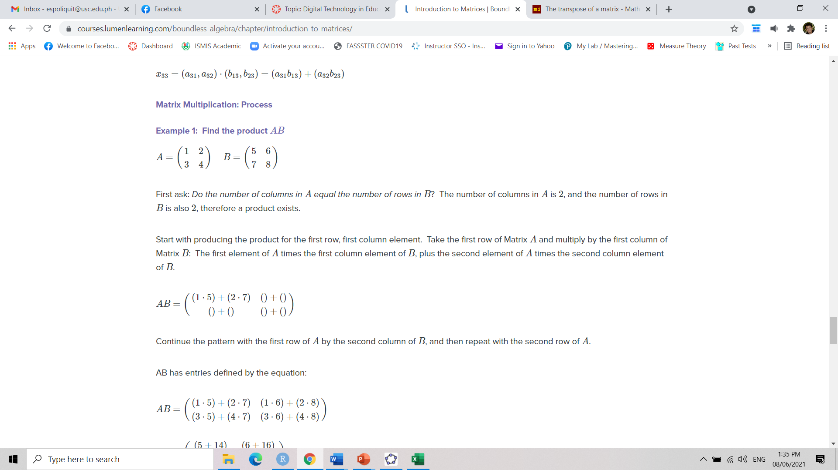
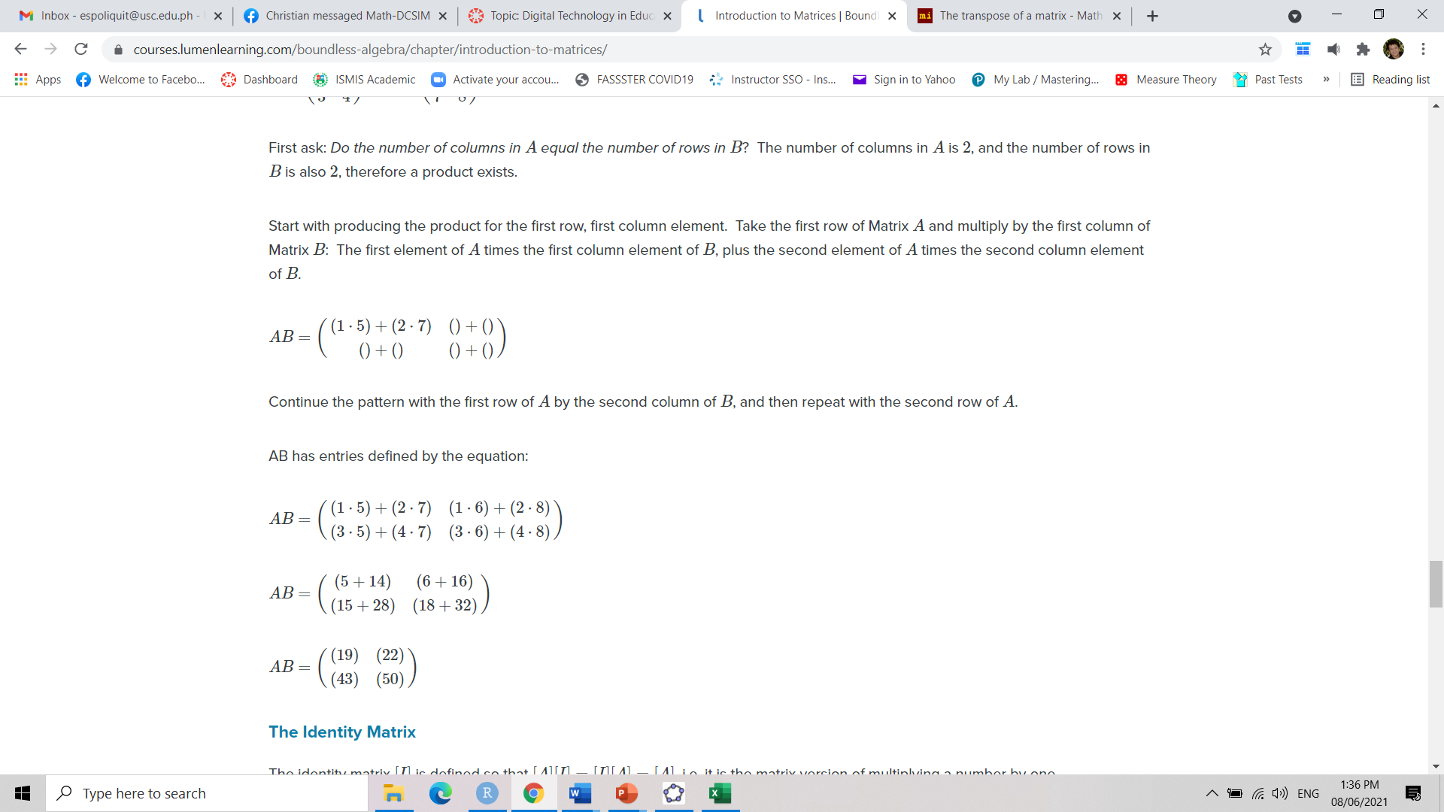
MATRIX
matrix1*matrix2 #simply multiplying the individual entry in each matrix
[,1] [,2] [,3]
[1,] 9 24 21
[2,] 16 25 16
[3,] 21 24 9
matrix1%*%matrix2 #in order to perform matrix multiplication in the linear algebra sense the operation * should be enclosed by "%“
[,1] [,2] [,3]
[1,] 90 54 18
[2,] 114 69 24
[3,] 138 84 30

Slide 27
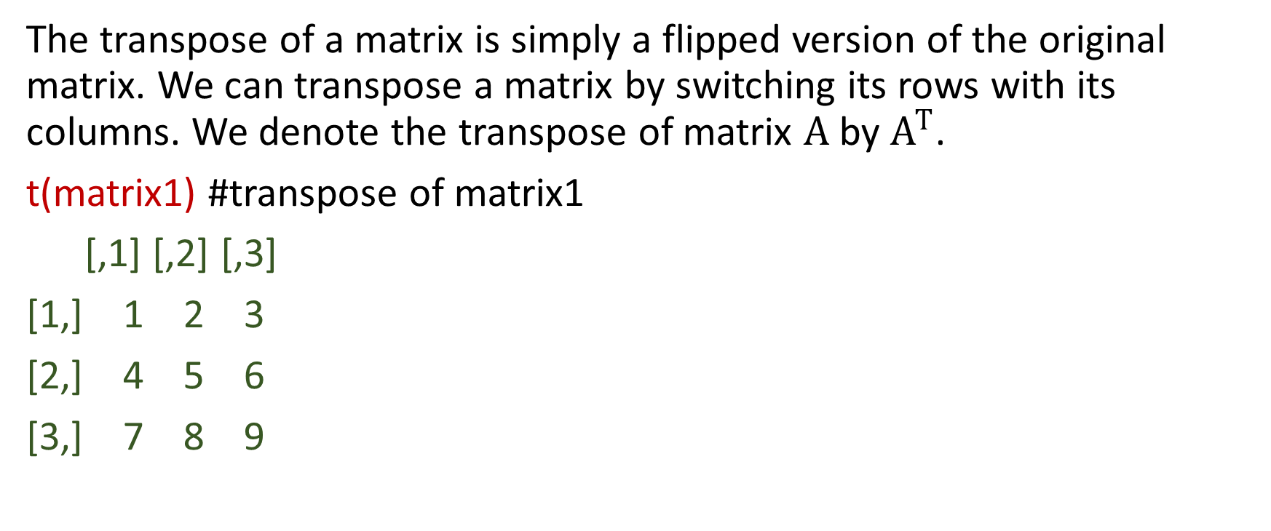
MATRIX
The transpose of a matrix is simply a flipped version of the original matrix. We can transpose a matrix by switching its rows with its columns. We denote the transpose of matrix $A$ by $A^{T}$.
t(matrix1) #transpose of matrix1
[,1] [,2] [,3]
[1,] 1 2 3
[2,] 4 5 6
[3,] 7 8 9

Slide 28
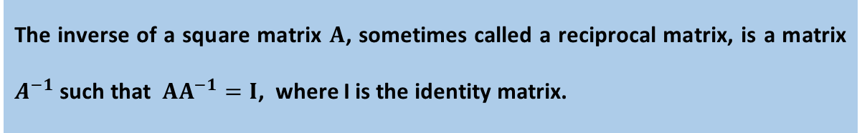
MATRIX
A=matrix(c(1,0,1,2,1,2,1,3, 0), nrow=3, ncol = 3)
A
[,1] [,2] [,3]
[1,] 1 2 1
[2,] 0 1 3
[3,] 1 2 0
B=matrix(c(1,0,0,0,1,0,0,0,1), nrow=3, ncol=3) #Identity matrix
B
[,1] [,2] [,3]
[1,] 1 0 0
[2,] 0 1 0
[3,] 0 0 1
The inverse of a square matrix $A$, sometimes called a reciprocal matrix, is a matrix $A^{−1}$such that $AA^{−1}=I$, where I is the identity matrix.

Slide 29
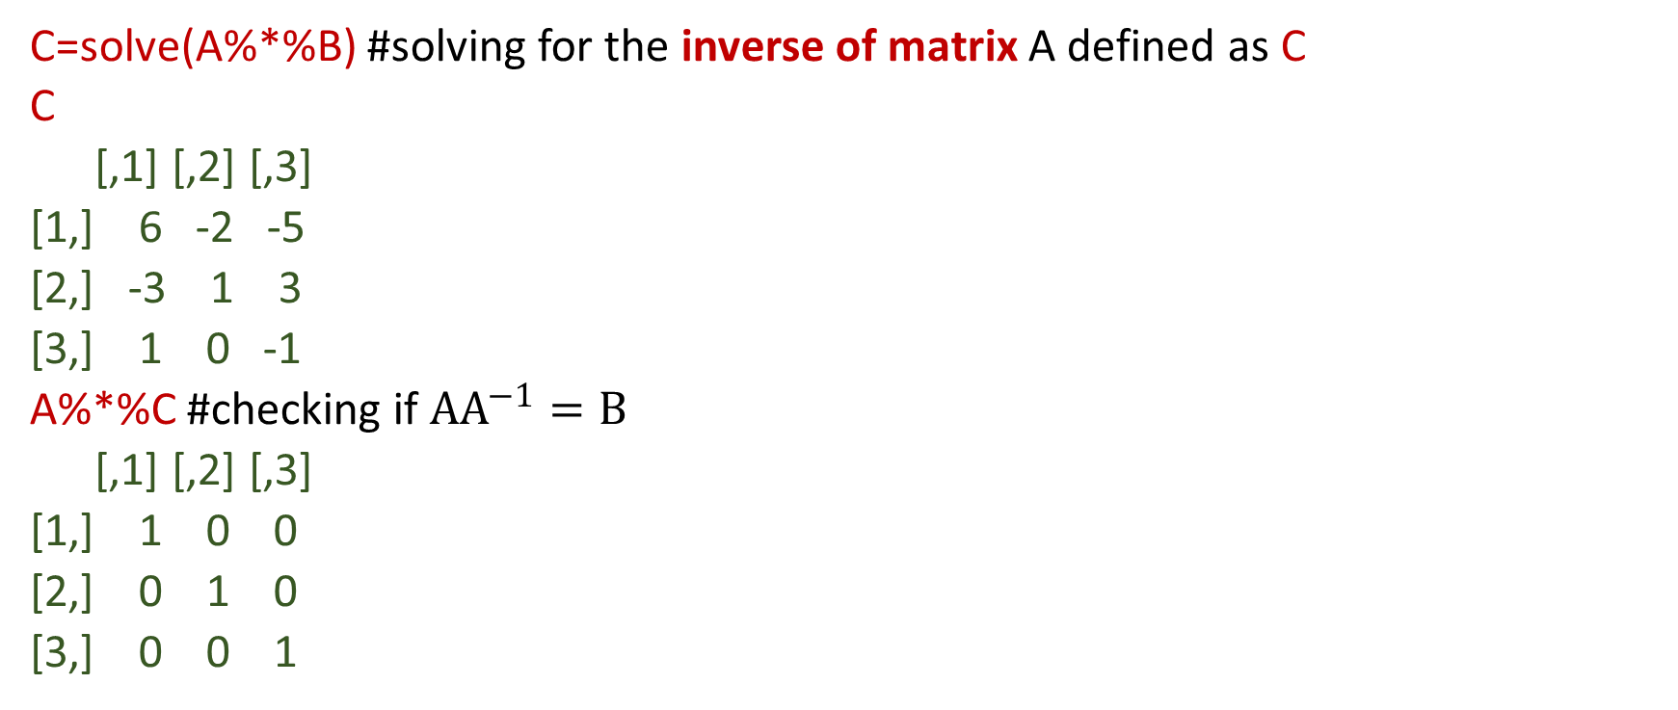
MATRIX
C=solve(A%*%B) #solving for the inverse of matrix A defined as C
C
[,1] [,2] [,3]
[1,] 6 -2 -5
[2,] -3 1 3
[3,] 1 0 -1
A%*%C #checking if $AA^{−1}=B$
[,1] [,2] [,3]
[1,] 1 0 0
[2,] 0 1 0
[3,] 0 0 1

Slide 30
MATRIX
class(matrix2)
[1] "matrix" "array"
matrix2[matrix2>4] #a Boolean operator uses true/false statements to decide which data to select → [1] 9 8 7 6 5
matrix2<2 #R has returned the matrix as a matrix of true and false values instead of numbers
[,1] [,2] [,3]
[1,] FALSE FALSE FALSE
[2,] FALSE FALSE FALSE
[3,] FALSE FALSE TRUE

Slide 31
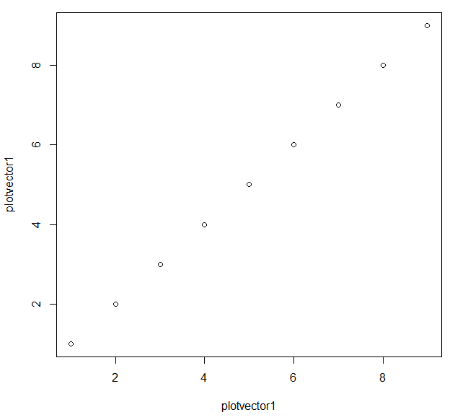
SCATTER PLOT
plotvector1 = 1:9 #dot plot is called through the plot() command
plot(plotvector1, plotvector1) #The plot() command takes in two

Slide 32
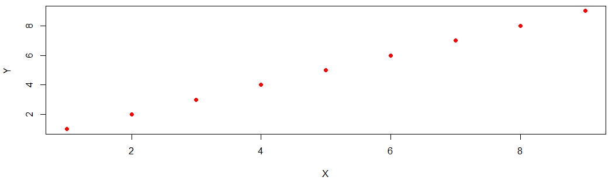
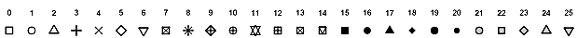
SCATTER PLOT
plot(plotvector1, plotvector1, xlab="X", ylab="Y", col="red", pch=16) #shape of the plot points to solid dot using "pch"

Slide 33
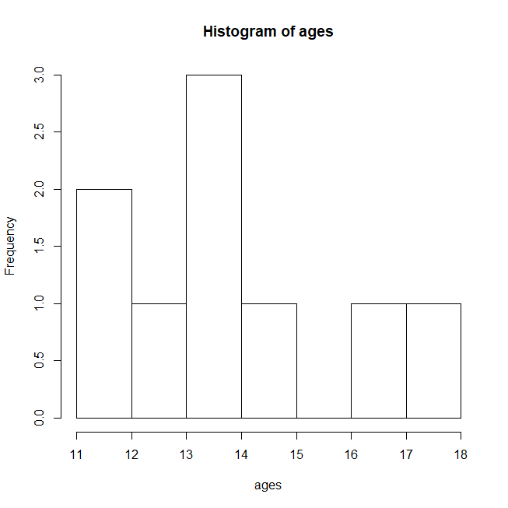
HISTOGRAM
ages=c(12,15,14,17,18,11,13,14,14)
hist(ages)

Slide 34
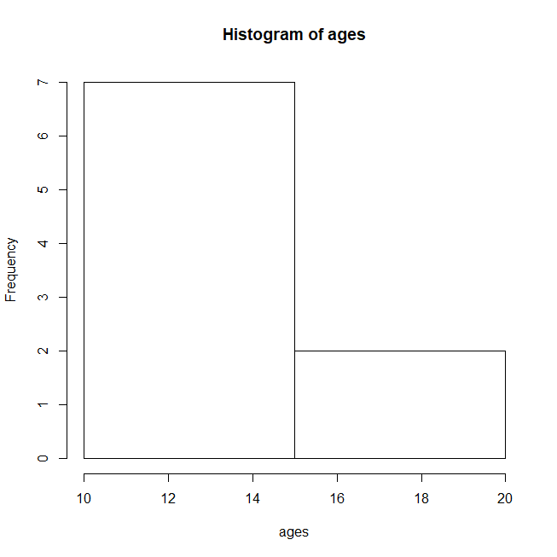
HISTOGRAM
hist(ages,breaks = 2) #breaks the bin into two

Slide 35
HISTOGRAM
hist(ages,breaks = c(10,11,12,13,14,15,16,17,18), xlab = "Ages of Children", col="blue")

Slide 36
HISTOGRAM
hist(ages, xlab = "Age of Students",ylab = "No. of Students", col="red",main = "Histogram", breaks =6)

Slide 37
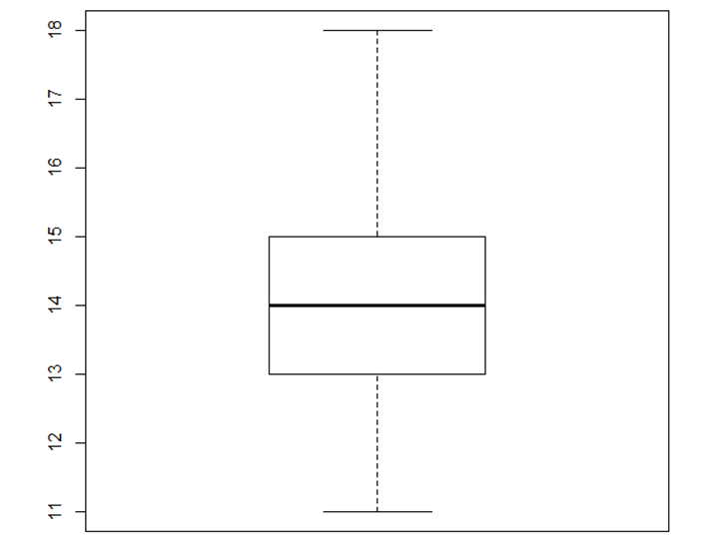
BOX PLOT
boxplot(ages)
boxplot(ages, horizontal=T, col="gold", xlab="Ages")
summary(ages) Min. 1st Qu. Median Mean 3rd Qu. Max.
11.00 13.00 14.00 14.22 15.00 18.00

Slide 38
STEM AND LEAF DISPLAY
stem(ages)
The decimal point is at the |
10 | 0
12 | 00
14 | 0000
16 | 0
18 | 0
x=c(1.2,1.1, 2.1, 3.1, 4.3)
stem(x)
The decimal point is at the |
1 | 12
2 | 1
3 | 1
4 | 3

Slide 39
Reading External Data
Data: correlationPCA
 | Hedonic | ForMeat | ForDessert | Price | Sugar | Alcohol | Acidity
Wine1 | 14 | 7 | 8 | 7 | 7 | 13 | 7
Wine2 | 10 | 7 | 6 | 4 | 3 | 14 | 7
Wine3 | 8 | 5 | 5 | 10 | 5 | 12 | 5
Wine4 | 2 | 4 | 7 | 16 | 7 | 11 | 3
Wine5 | 6 | 2 | 4 | 13 | 3 | 10 | 3

Slide 40
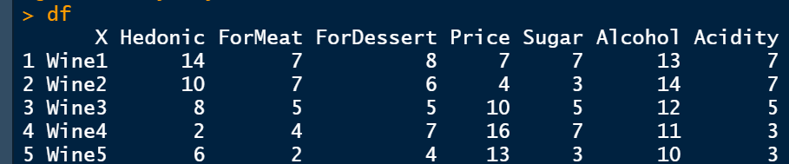
Reading External Data
getwd() # sample output "C:/Users/elms/Documents“
setwd("D:/Statistics Center/Tuklas Lunas Seminar Training") # working directory may be in different drive
df=read.csv("correlationPCA.csv") # excel file must be save as race.csv in set working directory
df

Slide 41
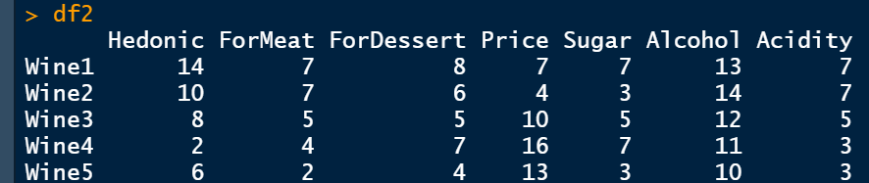
Reading External Data
df1=df[-1] #Removing column 1
df1
rownames=c("Wine1", "Wine2","Wine3", "Wine4", "Wine5")
df2=data.frame(df1, row.names = rownames)
df2

Slide 42
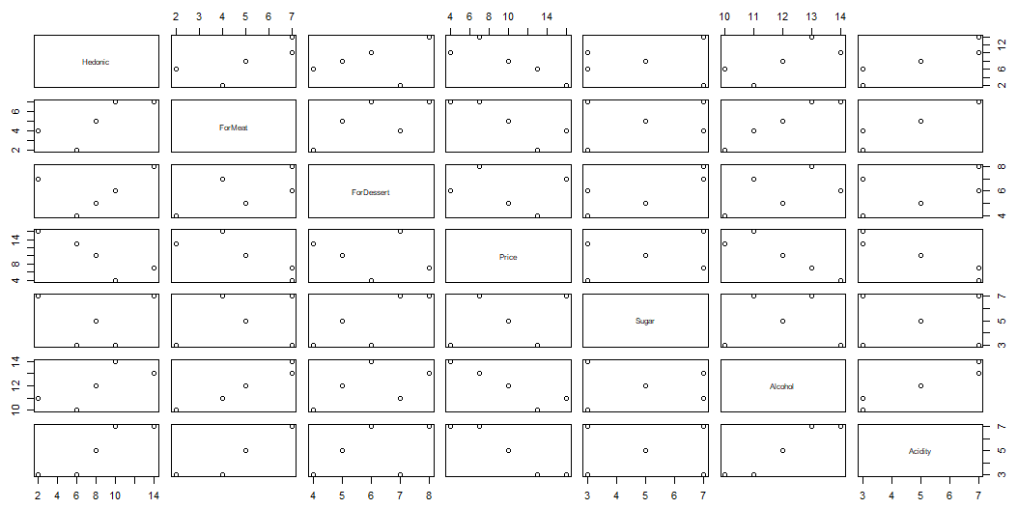
Reading External Data
plot(df2) #Scatter Plot

Slide 43
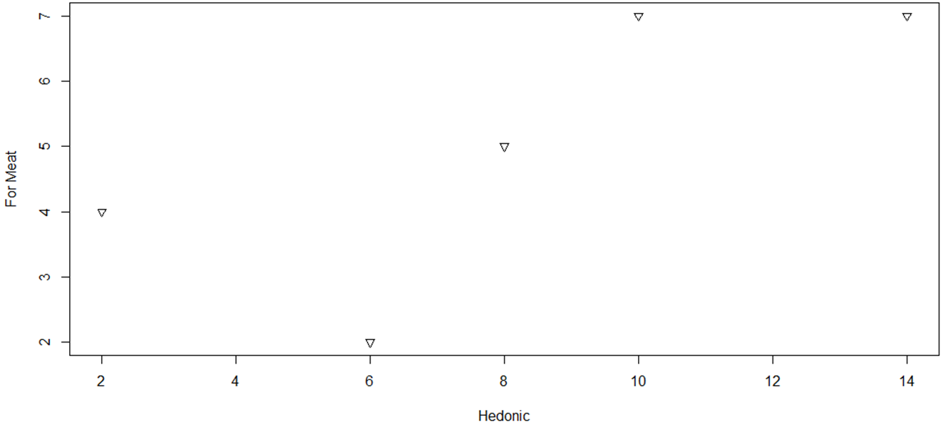
Reading External Data
plot(df2$Hedonic, df2$ForMeat, xlab = "Hedonic", ylab = "For Meat", pch = 6)

Slide 44
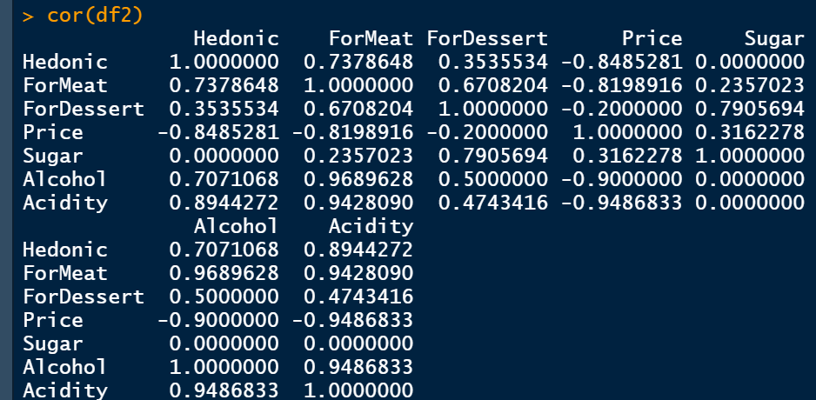
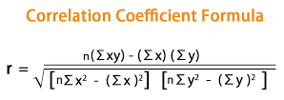
Reading External Data
cor(df2) #Correlation

Slide 45
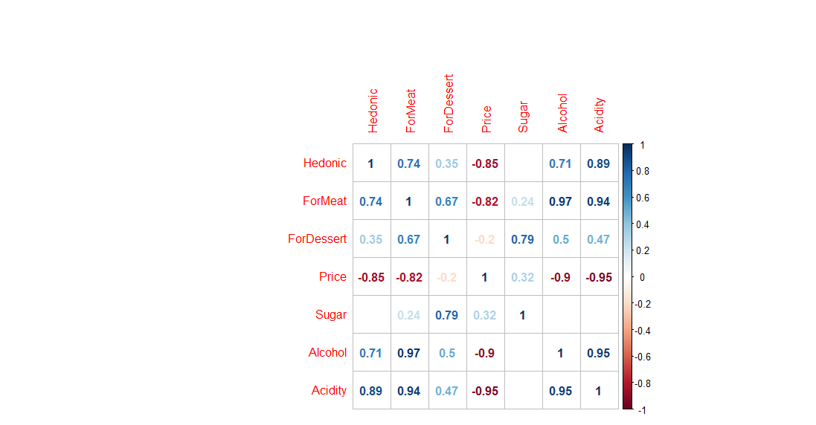
Reading External Data
library(corrplot)
cor=cor(df2)
corrplot(cor, method="number")#Better presentation
Character, the visualization method of correlation matrix to be used. Currently, it supports seven methods, named "circle" (default), "square", "ellipse", "number", "pie", "shade" and "color".

Slide 46
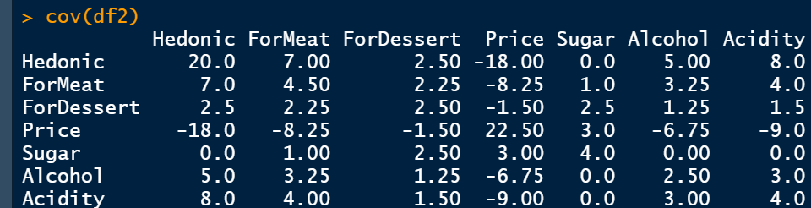
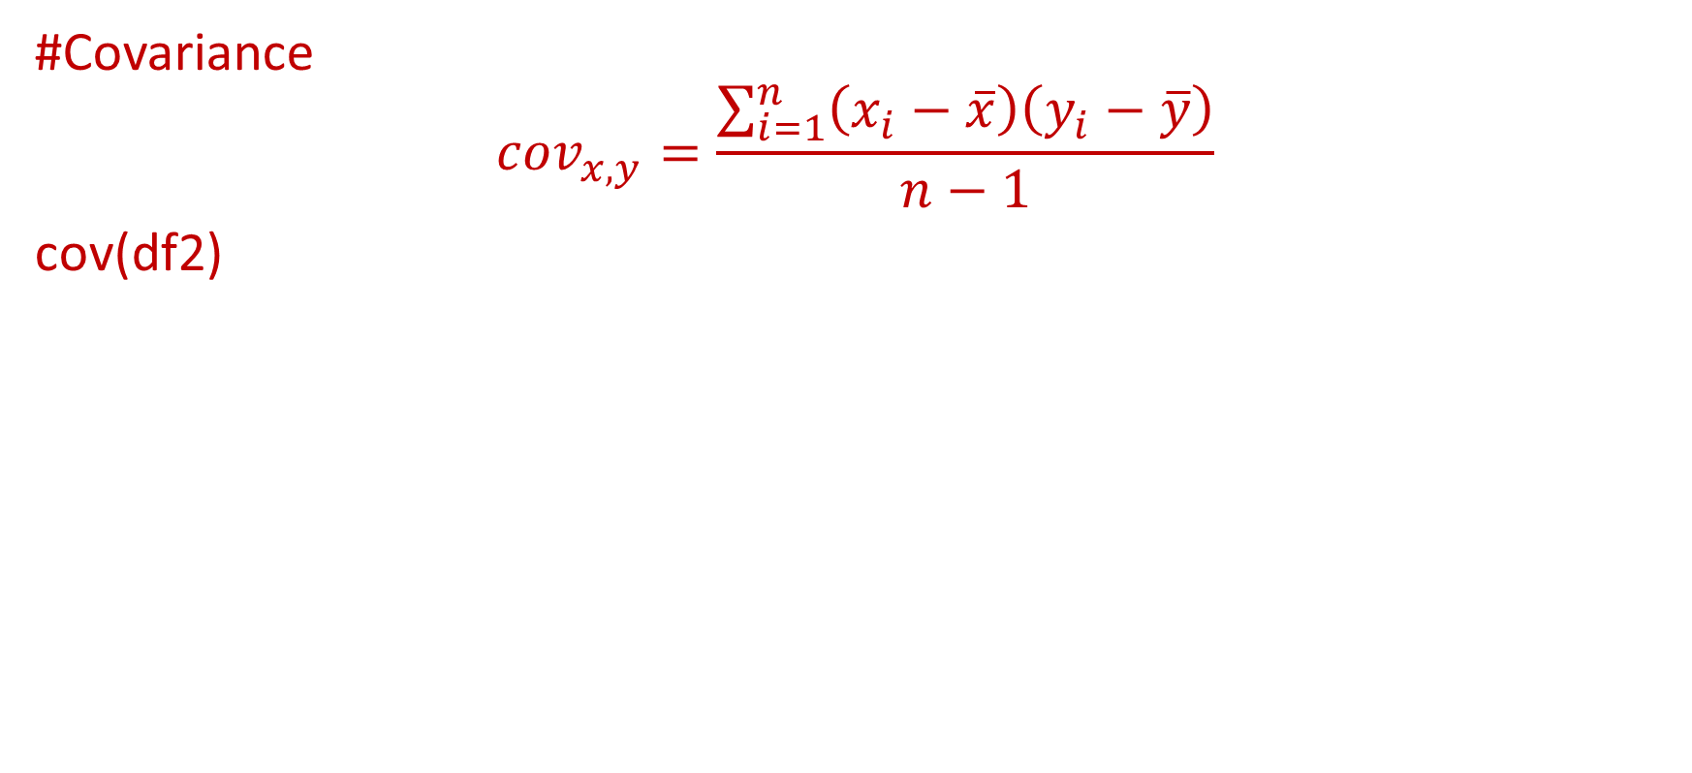
Reading External Data
#Covariance
$${cov}_{x,y}=\frac{\sum_{i=1}^{n}{\left(x_{i}−\overline{x}\right)\left(y_{i}−\overline{y}\right)}}{n−1}$$
cov(df2)

Slide 47
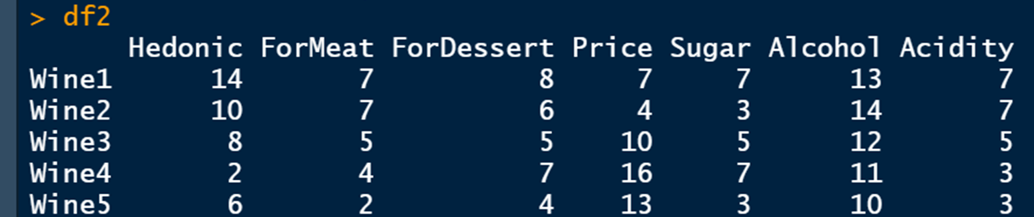
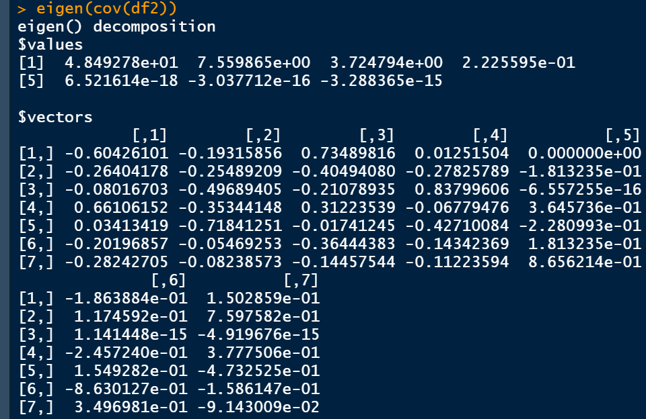
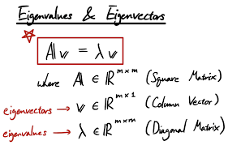
Reading External Data
#Eigenvalues
eigen(cov(df2))

Slide 48
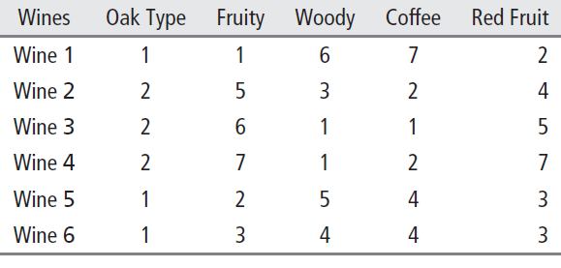
Activity 1
Data: Winesamples
Create a multiple graph of the data
Create a scatterplot with the highest correlation
Produce an eigen decomposition of the covariance

Slide 49
References
A beginner‘s introduction to the R programming language by Trevor Martin, Princeton University
https://courses.lumenlearning.com/boundless-algebra/chapter/introduction-to-matrices/
https://www.geeksforgeeks.org/r-stem-and-leaf-plots/

Slide 50
Thank you!

